Slide 1
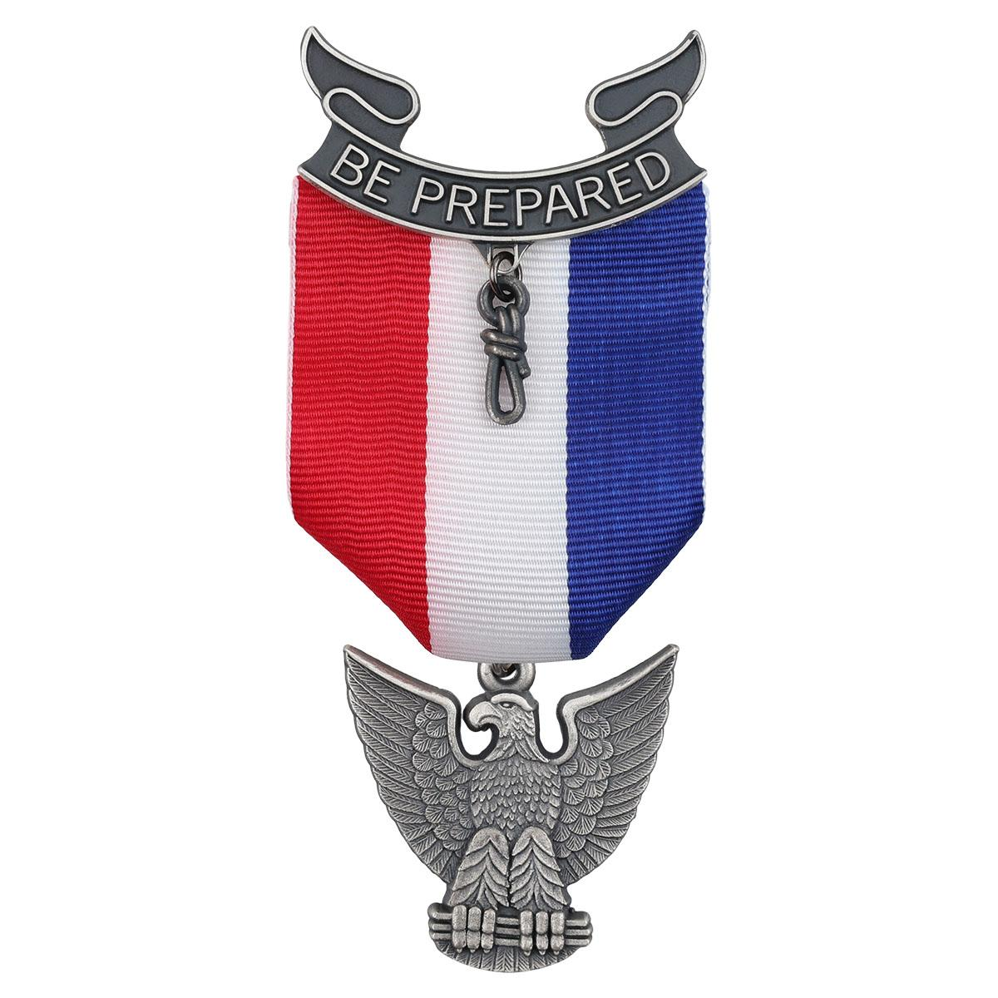

Life to Eagle:
Reaching the Summit
Process Overview
Eagle Service Project
Eagle Application Process
Eagle Board of Review
Eagle Court of Honor
Notes:
A Scout's Guide to Earning Eagle

Slide 2
Life To Eagle Outline
What MUST be Completed PRIOR to your 18th Birthday:
While a Life Scout…
Eagle rank requirements 1-6, in any order:
Six months active in Troop as a Life Scout
References Listed for Letters of Recommendation
Complete all 14 Eagle-required Merit Badges +7 more of choice
Six months in Position of Responsibility
Eagle Service Project Completed
Unit Leader Conference
Notes:
To get started, let’s talk about the things that are TIME SENSITIVE.
These are the 6 things that MUST be completed before your 18th birthday…
(slide)
BUT WHAT ARE YOU WAITING FOR…?? Plan ahead and don’t wait for the last minute to avoid the stress.

Slide 3
Life To Eagle Outline
What may be completed on or after your 18th Birthday:
Statement of Ambitions and Life Purpose
Signatures of Scout, Committee Chair & Unit Leader on Eagle Scout Rank Application
Delivery of Eagle Packet to the Council Office
Successfully complete your Eagle Board of Review
      Completed no later than 24 months after 18th Birthday
      Letters of Recommendation can be Accepted until EBOR
Conduct Eagle Court of Honor
Notes:
We don’t want you to wait until you’re up against a deadline, but if you’re cutting it close, these are the things that *could* be completed on or after your 18th birthday…
(slide)
Please Drive safely to deliver your Eagle Packet to Base Camp. We’ll talk about everything that goes into that a bit later.
but again… WHAT ARE YOU WAITING FOR…?? Plan ahead and don’t wait for the last minute to avoid the stress.

Slide 4
Life To Eagle Outline
What MUST be Completed PRIOR to your 18th Birthday:
While a Life Scout…
Eagle rank requirements 1-6, in any order:
Six months active in Troop as a Life Scout
References Listed for Letters of Recommendation
Complete all 14 Eagle-required Merit Badges +7 more of choice
Six months in Position of Responsibility
Eagle Service Project Completed
Unit Leader Conference
What may be completed on or after your 18th Birthday:
Statement of Ambitions and Life Purpose
Signatures of Scout, Committee Chair, & Unit Leader on Eagle Scout Rank Application
Delivery of Eagle Packet to the Council Office
Successfully complete your Eagle Board of Review
  Completed no later than 24 months after 18th Birthday
  Letters of Recommendation can be Accepted until EBOR
Conduct Eagle Court of Honor
Notes:
[This slide will only show if you go BACKWARDS to it in slideshow mode. It’s here for reference if someone needs a side-by-side view]
It also makes a handy printout for later reference.

Slide 5
Letters of Recommendation
REQUIREMENT 2. As a Life Scout, demonstrate that you live by the principles of the Scout Oath and Scout Law in your everyday life and tell how you have done your duty to God. List the names of individuals who know you personally and would be willing to provide a recommendation on your behalf.
The Scout is responsible for requesting references from the four people they listed on their application— this is a valuable life skill.
The responses are not to be viewed by or returned to the Scout.
Ask your Scoutmaster or Advancement Coordinator to whom your references should send their letters. Write it down!
You want references who answers “yes” enthusiastically when you ask. They should be excited to say great things!
A good reference is someone who knows you well, can speak to your character, and will complete the recommendation promptly…
Notes:
Start early. Soliciting references does not have to be the last requirement you complete – and in fact should not be.
You can start soliciting months before you anticipate having your Eagle board of review. This is an EASY place to start the day you earn Life rank!
Some tips:
Use the most appropriate communication channel. Does the other person (not you) prefer email, text, phone call, in person…? Using their preferred method of communication is courteous and will enhance your chances of getting a good recommendation.
Give instructions on how and where to submit their recommendation, and provide a pre-addressed envelope and stamp as a courtesy to those using mail.
Thanks for their time, even if they are not able to help you.
Explain what the recommendation is for, and how it will help you.
Mention reminders of your joint interactions, and how they positively affected you.
Include details on deadlines or any other timing issues.
Inform them that the reference that letters will be destroyed after the Board of Review, and will never be shared with the Scout or their family.
Now let’s talk about WHO you should ask…

Slide 6
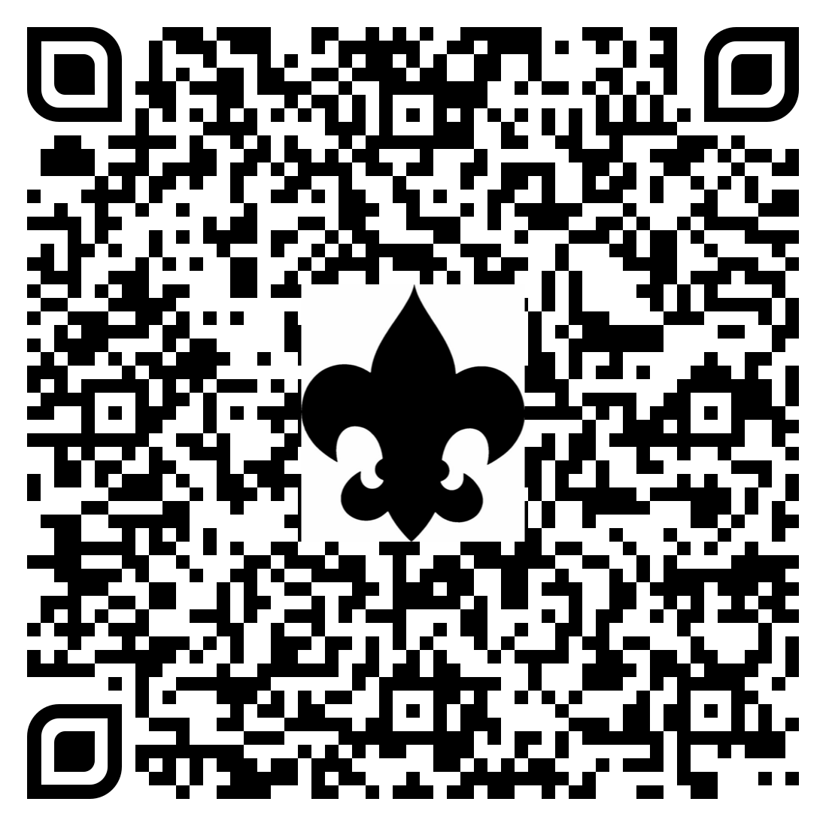
Letters of Recommendation
✅ Scout leaders, teachers, employers, coaches, faith leaders, other Scouts, etc. References do not need to be 21 or older.
❌ The current unit leader and committee chair are not eligible to serve as references; their signatures on the application are their endorsements already.
⚠️ Parents and other relatives are strongly discouraged from serving as references.
⏰ Request your letters NOW! Don’t wait for the last minute!
Northern Star Council has a helpful letter template references may use that includes instructions to the writer at “A Scout's Guide to Earning Eagle”
Notes:
Big change in 2025! Scouts request their own reference letters and it is highly DIScouraged to have parents be one of those references, whereas it was previously one of the listed requirements. The Scoutmaster signs the Eagle application and that’s their endorsement. Yes, your parents *could* write a letter, but it’s assumed they want you to be an Eagle Scout or they wouldn’t have brought you to hundreds of Scouting events for all these years, right? The board members want to hear from other voices. This is the official guidance on who should be asked to be references. [This is found on page 64 in section 9.0.1.3 under Complete the Application: References]
Commonly Asked Question: But what if your references never send in their letters?
A: If after diligent effort four recommendations are not received, the board of review can go forward without them. If the Scout chooses to go forward, the board may ask about their efforts, but may not deny advancement based only on lack of references. [Guide to Advancement, 2025: 9.0.1.7]

Slide 7
For Parent and Leaders
The Eagle Project is the Scout’s to lead. Parents are to encourage and guide, but the Scout leads the project!
The Scout should be making all phone calls to organize their project (contact with Beneficiary, District Representative, etc…) – not the parents!
As always in Scouting, Youth Protection policies apply throughout the Eagle Project process.
Private online communications (texting, phone calls, chat, IM, etc.) must include another registered leader or parent. (GtSS)
Notes:
Now for some advice for parents and other adults.
You can help by being in the background on speakerphone and by being the second adult on emails to assure there’s no one-on-one communications.
You can drive your Scout to meetings and to their project builds, or to meet with donors.
You can help out with whatever you Scout LEADS and asks for you to do- but they must ask first.
Wait for them to ask! They need to LEAD.
The Scout can run into problems with final approval if it becomes clear that an adult did all the work, so don’t sabotage the Scout!
[The link will direct you to the Guide to Safe Scouting.]

Slide 8
The Purpose of the Eagle Project
Demonstrate Ability to Plan, Develop, and Give Leadership
Use Learned Scouting & Communication Skills
Positive Experience in Project Management
Scouts should find a project that will be valuable to their community
and be a challenge for them to complete.
Ideas are found in many places – find something you are passionate about!
Scoutmasters Local Newspaper DNR
Faith-Based Orgs County Parks School
Other Eagles City Hall Library
Chartered Organization Parks Internet Search
Notes:
OK. Let’s spend a little time talking about how to start thinking about your Eagle Project. Then we’ll cover the actual requirement and the rules, who will help you, and then how to use the Workbook.
First and foremost, the requirement is to plan, develop and give leadership.
Find a project you feel passionate about – it will be a lot more fun!
Here are some great places to resource for ideas and needs in your communities.

Slide 9
Eagle Scout Rank Requirement #5
“While a Life Scout, plan, develop, and give leadership to others in a service project helpful to any religious institution, any school, or your community. (The project must benefit an organization other than Scouting America.)
A project proposal must be approved by the organization benefiting from the effort, your Scoutmaster and unit committee, and the council or district before you start. You must use the Eagle Scout Service Project Workbook, Scouting America publication No. 512-927, in meeting this requirement.”
(2024 rank update)
Notes:
This is the requirement, as it is written. No one can add to, take away from, or alter the requirement. It must be completed, as written. This is “what” you are doing. We’ll talk about the Workbook soon.

Slide 10
Eagle Scout Rank Requirement #5
In addition to providing service and fulfilling the part of the Scout Oath,
“to help other people at all times”,
one of the primary purposes of the Eagle Scout service project is to demonstrate, or hone, or to learn and develop leadership skills.
Related to this are important lessons in project management
and taking responsibility for a significant accomplishment.
Notes:
This is the “why” of what you’re doing when you’re working through your Eagle Service Project. It’s not just to check the box of finishing Eagle. It’s to wrap together all those skills in leadership you’ve learned as a Scout and use them to positively impact your world.

Slide 11
Guidelines and Restrictions
There are no required minimum hours for a project.
Routine labor is not appropriate for a project.
Projects may not be of a commercial nature or for a business.
Projects may not be a fundraiser as the primary effort.
More than one Eagle candidate may not receive credit for a project.
Project may not be performed for Scouting America, its councils, districts, units, or their properties.
Notes:
There’s going to be a box on your Eagle application that asks you for the total number of hours spent on the project. That’s for tracking purposes at National, but you’re also going to bring a roster of your workers and their hours to your board of review. This is so they have a little data to evaluate how you gave leadership to others, but there is no minimum. You can get a lot done with a lot of people in a little time, or almost nothing done in a ton of time with no people. Hours aren’t the real measure, but it’s something National tracks to show the value of Scouting’s volunteering.
Routine labor is something that has to get done on a regular basis, like mowing grass or repeated chores. If it’s something you’re coming in to do for a week and someone else is going to have to come back to do again next week, that’s not an appropriate Eagle project.
Ask “is this commercial?”. If someone else is profiting from you doing your project, the answer is probably that it’s not a good Eagle project.
We’ll talk more about fundraising to fund your project in a moment, but the project can’t just be to gather money or things.
Only one Scout can get credit for each project. That’s pretty self-explanatory. You can’t split a project into chunks and call it different projects.
Of course we want to give back to Scouting after everything it’s done for us, but we’re branching out from Scouting America for Eagle projects to show our community that we care about them. Our beneficiaries have to be non-Scouting.

Slide 12
The Five Tests of an Acceptable
Eagle Scout Service Project:
The proposal is an overview, but also the beginnings of planning.
It shows the unit leader and any representatives of a unit committee, council, or district that the following tests can be met:
  1. The project provides sufficient opportunity to meet the requirement.
  2. The project appears to be feasible.
  3. Safety issues will be addressed.
  4. Action steps for further detailed planning are included.
  5. The Scout is on the right track with a reasonable chance for a positive experience.
Notes:
So how do you make sure you project *is* going to be a good one?
The detail required for a proposal depends on project complexity. It must be enough to provide a level of confidence for a council or district reviewer that the above tests can be met, but not so much that—based on the possibility a proposal can be rejected—it does not respect the time it takes to prepare.
The unit committee is responsible for an approval of the proposal. It is acceptable for a troop, crew, or ship committee to designate representative(s) to act on its behalf. This is a unit decision. Neither the district nor the council may institute restrictions, such as how many committee members are to be involved.
We’re going to talk about Eagle Coaches and Concept review next.

Slide 13
Eagle Coaches & Concept Review
Concept review by the District is recommended for additional input and guidance, but not required. This may help validate project idea based on project guidelines and restrictions to ensure success.
It is strongly recommended that Scouts use an Eagle Coach from the unit or District. They serve as an advisor, consultant, and a resource, encouraging the candidate to fully plan the project, secure resources, and to make wise decisions.
Coach emphasizes those elements of a plan that, if ignored, could stop work or create health and safety issues and guides the Scout to evaluate the plan’s strengths, weaknesses, and risks.
Coaches shall NOT dictate changes, withdraw approval, or take any other directive action.
Notes:
A concept review is an optional step Before you’ve flushed out the whole idea in the Workbook and put lots of writing and planning into your idea. It’s the “would this make a good project?” meeting to see if your idea meets the 5 tests and follows the guidelines and restrictions to give you confidence to dive in!

Slide 14
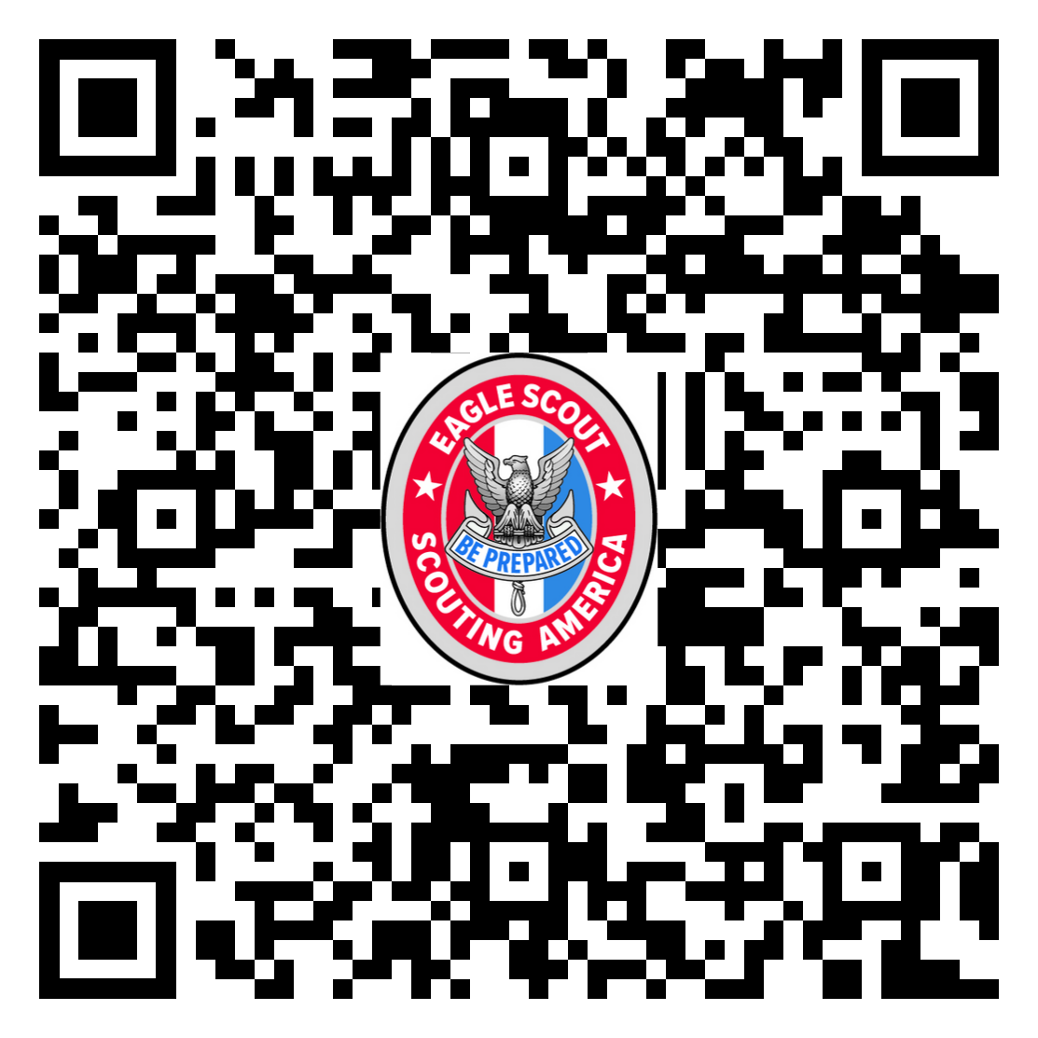
Your District Eagle Team
Contact for Concept Input and Project Proposal Approval
They coordinate the Eagle Board of Review
Find your District Representative’s current contact information listed on Northern Star Council’s “Eagle Advancement Team By District” button on A Scout's Guide to Earning Eagle.
Notes:
We keep talking about the District approval and the District Representative and District this-and-that. So WHO IS THIS PERSON??
The District Eagle Team is key to getting your project concept and proposal approved. Here is how to find the contacts for your area.
We keep a nice spreadsheet in one place we can update for your convenience.
Remember to include a second adult on all communications! If you forget, you might not (won’t) get a reply.

Slide 15
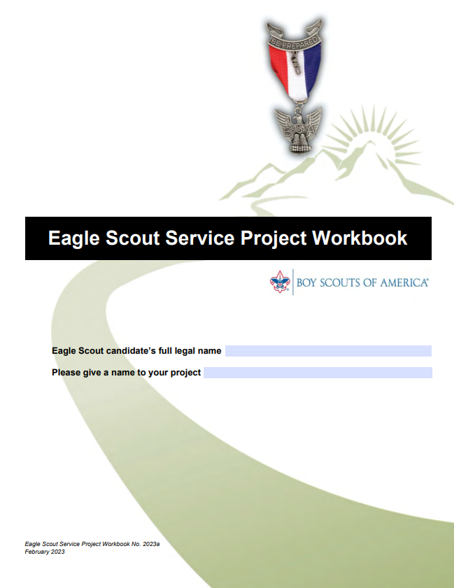

Eagle Scout Service Project Workbook
Scouts MUST use the latest revision [BSA #2023a] which may be found at Northern Star Council’s A Scout’s Guide to Earning Eagle.
The Eagle Scout Service Project Workbook can be downloaded for free and used as its native fillable .pdf or printed and hand-written neatly.
READ THE INTRODUCTION
AND INSTRUCTION PAGES
CAREFULLY!
Notes:
Use the current and official workbook – either print or download and fill in the PDF. The instructions pages are SO important. Read them!
Now for some tips on HOW to use it for minimizing frustration and maximizing success…
**There’s likely to be a new version with Scouting America branding soon- we’ll be keeping watch for it!

Slide 16
Tips for Workbook Success
Download the Eagle Project Workbook and save it to your computer or cloud drive before editing.
Rename the Eagle Project Workbook file to include your first and last name and close file.
Open Acrobat Reader (available free from adobe.com)
Open renamed Eagle Project Workbook file with Acrobat Reader.
Make a few changes, save, close then reopen the file to make sure it saved properly.
After verifying the updated file is saved properly, it is safe to make more extensive changes.
Be sure to save your work frequently!
Notes:
Save. save. save. save. save.
Can’t say it enough.
And keep another copy.
DO NOT USE THE E-SIGNATURE FUNCTION, if you can help it. Have people sign in person. Once one person signs electronically, it will lock out other signatures, limiting the document’s functionality.

Slide 17
Intro: Parts of the Workbook
The Project Proposal – In detail, explains the project’s purpose, methods, materials, and the scope of work.
The Fundraising Application – if needed, this must be approved through the district when ‘written approval’ is given.
The Project Plan – Refinement of details with specific plan of action.
The Project Report – Written after the project is completed.
This is not a form. It is a Workbook to be completed with enough detail to define your project so others understand your intent and process.
Notes:
Briefly, these are the parts of the Workbook.
The Project Proposal – In detail, explains the project’s purpose, methods, materials, and the scope of work.
The Fundraising Application – if needed, this must be approved through the district when ‘written approval’ is given.
The Project Plan – Refinement of details with specific plan of action.
The Project Report – Written after the project is completed.
We’re about to go into a lot more detail, but first, some more information about that fundraising “if needed” part.

Slide 18
Fundraising Application
Guide to Advancement (9.0.2.10)
Projects may not be fundraisers.
Fundraising is permitted only for securing materials and otherwise facilitating a project.
Fundraising must be approved by the local council except for contributions from the beneficiary, the candidate, the chartered organization, and the candidate’s parents, guardians, or relatives, as well as the unit or individuals in the unit.
Highly Recommended: Bring Completed Application To The District Review. It just saves you a trip!
Notes:
In other words, the candidate must not stage an effort that primarily collects money, even if it is for a worthy charity.
If the only folks giving you money are your family, other Scouts and Scouters wearing your unit patch, your unit, your chartered org, and the beneficiary of the project, you don’t need approval. If ANY other person or group or organization or business, etcetera, donates = fundraising application.

Slide 19
Details: Steps to Completion
Concept: Briefly describe your project to Unit/Coach for go-ahead.
Project Proposal: Lots of details! Signed by Scout, and approved by Beneficiary, Unit Leader, Unit Committee, and District Approval.
Fundraising Application (if needed): Be comprehensive. Approved by Beneficiary, Unit Leader, Council
  Must have all approvals to start the project and/or fundraising!
Project Plan: Prepare for your project in even more detail.
  DO THE PROJECT!
Project Report: How’d it go? Signed by Scout, approved by Beneficiary and Unit Committee
Districts may handle the Project Proposal Approval a little differently...
Check with your District’s Eagle Team for more information.
Notes:
Optional: The Concept presentation makes sure you are heading down a solid path before you put too much time into the Project Proposal.
Proposal. Use as much detail as possible. Imagine someone has never heard of an Eagle project before and the only thing they have describing it is your workbook. Tell the story! What are you doing? How are you doing it? What do you need? How will you get it? How are you being safe? How much are you spending? Who is working with you? Will there be pizza??
Fundraising: Review the Fundraising application if you will be raising funds – there are detail on the form. Do not start to do any fundraising or work on the project before you get formal project proposal approval – a signature from the district representative. You’re writing about spending other people’s money. Convince them you need it by showing the math. It’s really just that simple, but do the math to the best of your ability. Any money left after the project is over belongs to the beneficiary, so excessive fundraising is discouraged. If the beneficiary cannot accept donations, they can designate a charity to receive excess funds on their behalf. Money fundraised for an Eagle project never belongs to the Scout or the Scout’s unit or Chartered Org.
Plan: Once your proposal is approved, spoken to the district representative, worked with an Eagle coach, and talked through what you’re proposing, the Plan is for fine-tuning any additional information and changes. use the project plan to prepare for your project in more detail so if something happens to you, your written plan can still provide leadership in your absence!
Do your project. Have fun!
Report: When everything is done, the Report is the story of What Happened. How did it go? What did you learn? What was hard and what surprised you? These are questions you’re likely to hear at your Eagle Board of Review, so give them some thought.
The final step is to have your unit leader and beneficiary sign off that they believe you have completed requirement 5. You sign it too!
Easy, right?
Signature pages are Proposal Page H, Fundraising Application Page A, and Report Page C.

Slide 20
Eagle Scout Projects – Do’s
✅ Do begin planning project early! Most Scouts say it takes 6-12 months to carry out their project from beginning to end.
✅ Do provide as much detail as possible for yourself and your team.
✅ Do plan out the costs of materials to buy or be rented.
✅ Do plan out tools to be purchased, borrowed, or rented.
✅ Do plan out who will be contacted for donations.
✅ Do use an hour-by-hour time schedule - it’s easier to follow.
✅ Do get signatures from yourself, your Unit Leader, your Unit Committee, and your Beneficiary before seeking District written approval.
✅ Do plan for the dates available for District review.
Notes:
WHY:
Details help your team know what to do in the event that you assign them with going to get things or you suddenly can’t be somewhere and need to delegate a task. You’re going to want your workers to get their service hours for their own advancement, so you need to keep track of that list for both them and for yourself. It’s kind and helpful. If your District only holds reviews every so often, plan ahead. As your District Representative if there’s any deadlines or blackout dates coming up.

Slide 21
Eagle Scout Projects – Don’ts
❌ Don’t begin work on your project until District approval is given.
    This includes requesting and accepting donations.
❌ Don’t expect quick turn around from District volunteers
    It usually takes Volunteers at least a day or two to respond to phone messages and emails.
❌ Don’t wait until only two months before your 18th birthday!
❌ Don’t expect things to move fast during the summer when Volunteers are on vacation or at camp with their units.
Notes:
WHY:
Work started before approval doesn’t count towards your project and may actually cancel the whole thing! Don’t do it!
Volunteers are busy people so please keep that in mind and plan ahead- and remember to CC: in email a second adult so we can respond!!
Demonstrate: “Hello, this is Joey McScout from Troop 1000, I’m here with my mom- (This is mom, Beth McScout. It’s my cell, so please call back!) calling about my Eagle Project. We can be reached at…”
If your 18th birthday deadline is approaching TELL US NOW in the first call or email!! Don’t wait and hope we telepathically know.

Slide 22
Time Extensions
The three tests a council is to apply in evaluating a request for an extension are covered in the Guide to Advancement 9.0.4.0
If a Scout foresees that due to no fault or choice of their own, it will be impossible to complete the Eagle Scout rank requirements before age 18, they may apply for a limited time extension.
Extensions to shall only be granted to youth in Scouts BSA who have already achieved Life rank.
If approved, the notification must be attached to the youth’s Eagle rank application.
Upon turning 18, the Scout must submit a completed adult application and successfully complete Youth Protection training. Their participant code will now be “UP” for Scouts BSA.
In the unlikely event a Scout requires more than six months, the council is not permitted to approve the request. The Scout can then appeal to the National Council, as described in Section 9.0.4.2.
Contact Dave Arola with any questions or to file an extension. Darola@northernstar.org
Notes:
But what if something unexpected is happening while you’re a Life Scout and things are looking bleak for finishing in time for your 18th birthday?
Extensions are RARE and must pass Three Tests to qualify for consideration.
When a time extension is requested, the Scout should continue working on the requirements until a final decision is delivered.
These are most often situations of a hospital stay, disabling injury, significant personal or family incident or issue, natural disaster, severe unseasonable weather, or the actions of others that significantly misinformed advancement requirements.
Scouts with permanent and severe disabilities such as those described in section 10, “Advancement for Members With Special Needs,” have the opportunity to be registered beyond the age of eligibility. They do not need to request an extension. GTA 10.1.0.0
(Note: Old to New- Change from a maximum of 3 months from 6 months at council level.)

Slide 23
You’re Nearly There!
IF…
✅ Eagle Scout Service Project Workbook: Project Proposal Page H, Fundraising Application Page A, and Report Page C have all signatures…
✅ Position of Responsibility Requirement: completed, approved & recorded in Scoutbook…
✅ Required Merit Badges: completed, approved, awarded & recorded in Scoutbook…
✅ Scoutmaster Conference: completed, approved & recorded in Scoutbook…
THEN… it’s time to Complete the Eagle Rank Application!
Prepare your Statement of Ambitions, Life Purpose and Leadership outside of Scouts to include with application. Include a list of Positions held, Honors, & Awards.
Final requests for Letters of Recommendation not yet received
(you started this months earlier, right?)
Notes:
Now you have finished all the big requirements other than a Board of Review, what do you do? Complete the application and get it turned in with everything else in the Eagle Packet.
Tons of Scouts miss the bit on the Application right by their Signature about this Statement of ambitions, but you’re going to BE PREPARED because you’ve seen this presentation and you’re well-informed. Get this written and give it to the person collecting everything going into your paperwork.
Ask the person collecting your Letters of Recommendation if they’ve received all four yet and, if not, give your procrastinating references another cheerful reminder. If they’ve become unable to provide a reference for some reason, you can ask someone else and swap out their name and information on the application.

Slide 24
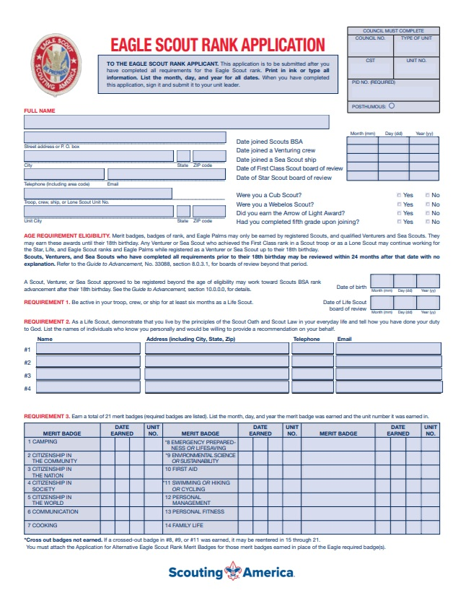
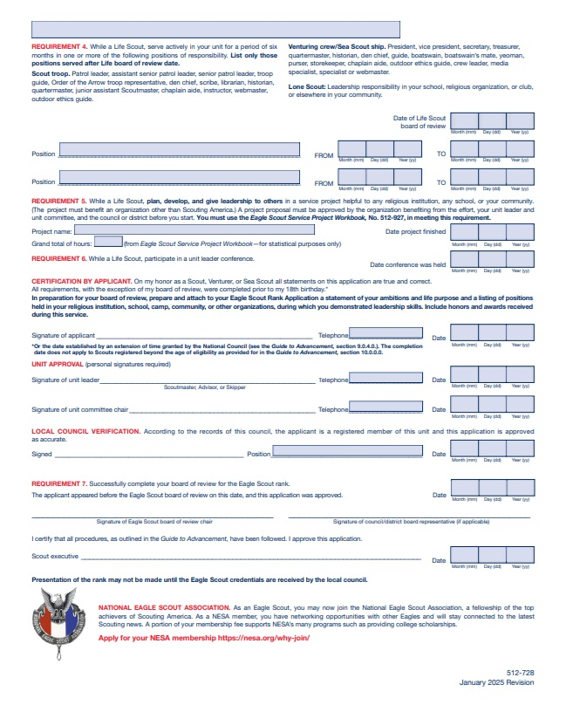
Eagle Scout Rank Application
Scoutbook scoutbook.scouting.org
Download the customized, partially filled-out application from your Scoutbook Profile ⇾ Reports ⇾ Eagle Application.
Complete all missing information, Save, and Print.
Get Signatures from the Scout, Unit Leader & Unit Committee Chair.
Make a Copy, then give the application directly to the person who will deliver the Eagle Packet to the council office.
You can also download a blank fillable .pdf form from: scouting.org/advancement
Notes:
Use the current and official Eagle Scout Rank Application. You can find this on the National or Council website…
Note the change from “legal name” to “full name”. National now allows Scouts to use their chosen name or a nickname - rather than legal or birth name- on their Eagle Rank Application. This will be their name as it appears on their Eagle certificate and wallet card, so the Scout should triple-check spelling!
Scouts usually get this form from their Scoutmaster, Advancement Coordinator or Eagle Coach. Ask your Unit who has Scoutbook access to print this out.
The Scout has to SIGN IT. The Unit Leader has to SIGN IT. The Unit Committee Chair has to SIGN IT.

Slide 25
Preparing the Eagle Packet
The Eagle Packet should contain:
  Contacts Postcard – Unit leader completes this card
(Council notifies via email when you’re approved by National!)
  Eagle Rank Application - Completed, Printed, & Signed!
  Statement of Ambition and Life Purpose & List of Positions, Honors, & Awards
  Letters of Recommendation
  Eagle Scout Service Project Workbook - Completed/Approved
  Roster of Eagle Project Workers’ Hours
  All Letters/Forms of Extensions, ISAP, Alternative Merit Badge Approvals, RBAE, and/or Belated Rank.
Submit Packet in single sheets- NO staples, folders, sheet protectors, or binders
Notes:
During your Scoutmaster Conference, your Scoutmaster should tell you WHO will be responsible for collecting this together and what you need to do.
It may be your Unit Leader, the Advancement Coordinator, your Eagle Coach or another designee, but everything should be gathered in ONE VERY SAFE PLACE.
It’s wise for the collection person to make a copy of everything. Crazy things happen.
Your materials are going to be scanned once they’re at the Council, so NO staples, folders, document protectors, weird metal clippy things… Keep it nice a simple and give our Eagle Advancement Specialist an easy day please.
TIP: Print this page and use it as a checklist.

Slide 26
Turning in Your Eagle Packet
Your complete Eagle Scout Packet can be hand-delivered to the Northern Star council office during regular business hours.
Mailing originals is not a risk you want to take, but you could send copies.
You may be asked to scan in all your documentation for a virtual EBOR.
Every District has a preferred method. Contact YOUR District Eagle Representative to find out the most efficient way where you live and WHO turns in your Eagle Packet in your district.
Submitting completed paperwork to the council office after turning 18 does not need an extension as long as all requirements were met prior to turning 18.
Notes:
ALWAYS make a copy of everything in your packet before turning anything in - just in case.
Please don’t cause a wreck trying to get to Base Camp 1 minute before closing the day before your birthday.
Firstly, please don’t wait that long. But secondly, revert back to the Guide to Advancement and breathe. Get your requirements done on time and those couple of signatures, and you’re ok.
WHO brings/sends the Eagle Packet is up to the unit/district. Ask your District Rep if there’s a specific policy and go from there. Whoever handles it must be trustworthy and prompt.
It generally takes 1-2 weeks to review the Eagle Packet and hear back that you’re approved to proceed to an Eagle Board of Review.

Slide 27
The Eagle Board of Review
Composed of 3 to 6 members that may include unit committee members, leaders from your surrounding units, community-at-large, or District.
Boards may be done in-person or virtually via video conference.
ASM’s and family may not be present, but can wait in a lobby or elsewhere for the BOR decision.
Scoutmaster may attend silently if the Scout welcomes their presence.
The Eagle Board of Review decision must be unanimous.
Suggested to dress in your Troop uniform to showcase your Scouting career. If you cannot or choose not to, then dress neatly.
Bring your Scout Handbook and supporting materials to share your Eagle Project.
Accommodations are available for Scouts with disabilities or special needs.
Notes:
Each District has different policies and methods of forming Eagle Boards of Review, which your District Representative can advise you about, but here are the general guidelines.
(slide)
Once you’ve completed your Eagle Board of Review, your date of Eagle Rank (and any additional Eagle Palms earned) have the date of that board, you’re an Eagle, and it’s time to plan the celebration!

Slide 28




The Eagle Court of Honor
The Eagle Court of Honor should be planned by the Scout and their family after official notification of rank advancement confirmation from National. (Times vary but usually average 2-4 weeks…)
Make it your own – with your style to including what’s important to you! Incorporate your fellow Scouts and special leaders into the program.
Present adults who were especially helpful with a Mentor pin- one comes in your award kit and more are available from the Scout Shop. They also have a Grandparent pin and additional Mom/Dad pins.
Northern Star Council has several Eagle Court of Honor decoration boxes for complimentary use that include banners and flags, and your unit may have additional resources. A Scout is thrifty!
Notes:
‹#›
Your FREE Eagle Award Kit will come from council and it includes (in a very nice box): 1 Eagle Scout medal, 1 Eagle Scout rank patch, 1 Mom pin, 1 Dad pin, 1 Mentor pin, Eagle Certificate, Eagle wallet card, Letter of Congratulation from Scouting America CSE. (Plus some additional information about your next steps as an Eagle Scout.)
Your Eagle kit does NOT contain an Eagle neckerchief or slide… but before parents run to the Scout shop they should speak with the unit and find out what traditions the unit has about such things. Many units give these to mark the achievement- some do, some don’t. Have a chat!
(As of April 2025: Be advised that Eagle Certificates and wallet cards are delayed, pending issues with obtaining new POTUS signature. Roger Krone, Chief Scout Executive/President, CEO sent out a letter saying NOT to delay an ECOH waiting on these items, so long as the rank has been approved.)

Slide 29
Where to go for more information
“A Scout's Guide to Earning Eagle”
Includes:
Eagle Project Workbook
Eagle Application
Eagle Reference Letter Template
District Advancement Representatives
This “Life to Eagle” Presentation
Contact Information for Eagle Team
Scouting America’s Advancement Resources Page
www.Scouting.org/advancement
Notes:
Everything you’ve seen tonight- including THIS presentation- is available on the Northern Star Scouting’s website for you to grab any time you need it. Please do. It’s there for you. All the additional forms mentioned are also available from Scouting America’s own website.

Slide 30
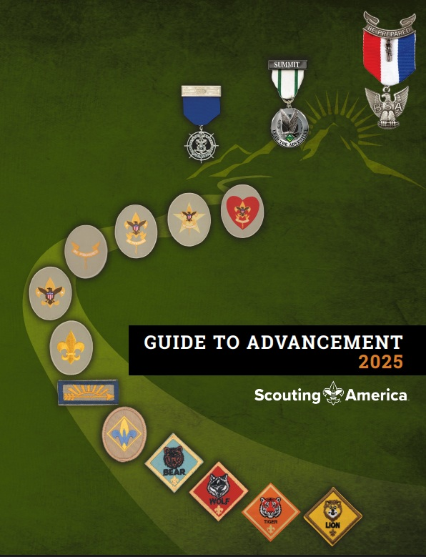
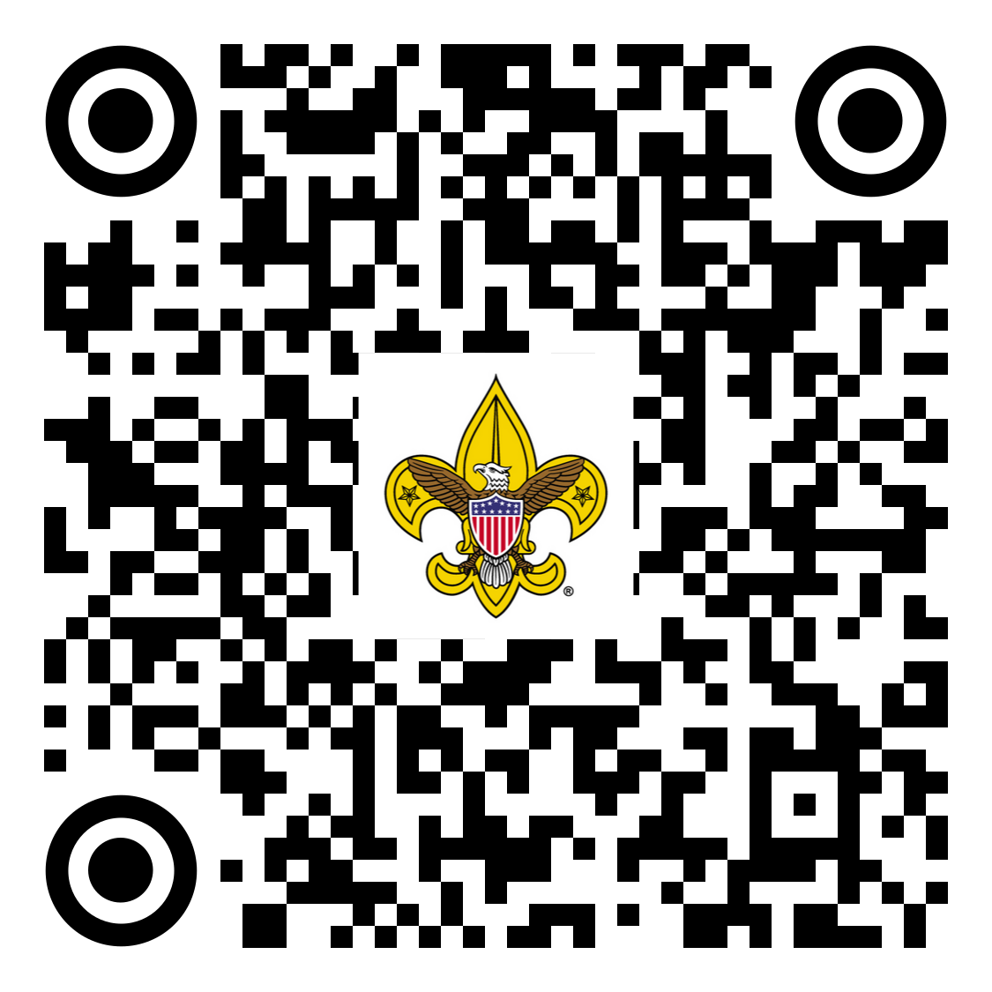
Thank You
Scouts and Adult Mentors!
Guide to Advancement
All New in 2025!
Available Online HERE.
This Presentation was written by incorporating the expertise and experience of the Northern Star Council’s Advancement Committee,
most of whom are District Advancement Chairs (volunteer leaders) who work with Eagle Candidates all year long.
Notes:
The Guide to Advancement is the source for all final answers on Advancement!

